Slide 1

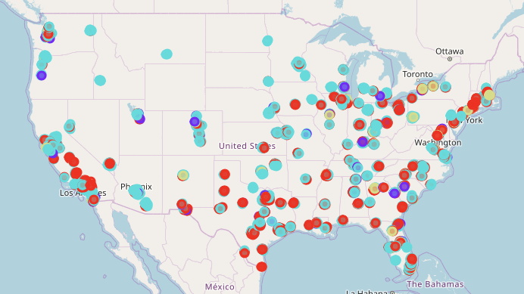

Market Segmentation of Beer Focused Venues

Slide 2
Introduction
Potential questions this project hopes to answer:
Which age group is more prevalent in markets with a high ratio of beer venues?
Which markets have a high prevalence of beer venues?
What are potential markets for opening beer venues?
Notes:
Taprooms, beer bars, breweries and other similar themed venues have become a popular hangout spot in the US during the past years (1). Understanding the demographical commonalities around these beer focused venues can unlock key insights for breweries and venue owners around the US. These insights can be used for marketing campaign targeting, defining customer profiles or even guiding decisions of where to establish a new business.

Slide 3
Data
Demographical Data Used
INCOME AND BENEFITS (IN 2018 INFLATION-ADJUSTED DOLLARS)
COMMUTING TO WORK
EMPLOYMENT STATUS
GROSS RENT
SEX AND AGE
RACE
HISPANIC OR LATINO AND RACE
PLACE OF BIRTH
MARITAL STATUS
EDUCATIONAL ATTAINMENT
Sources:
Foursquare API – Beer Venues
Census API
All data at Zip Code Tabulation Area Level

Slide 4
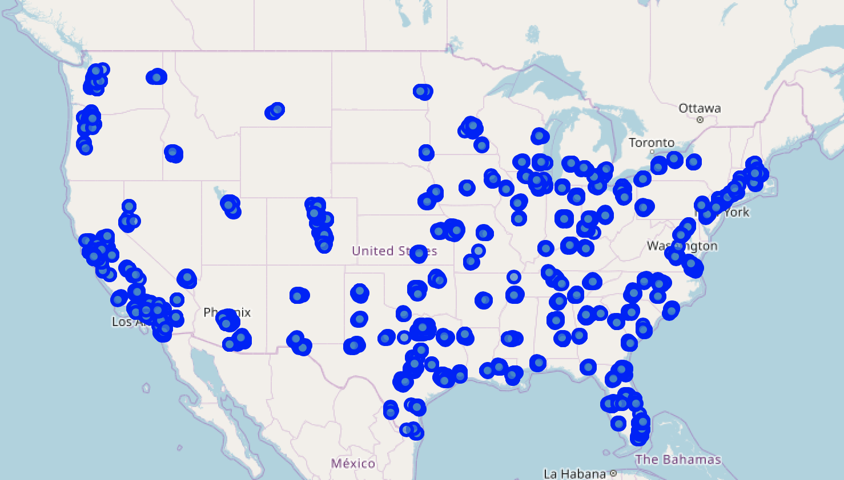
Preprocessing
Neighborhoods Analyzed
Foursquare API call per neighborhood with 1000m radius
US Cities with more than 100k inhabitants
3544 neighborhoods analyzed
171176 total venues
Venue Category | Number of Venues
Brewery | 1221
Beer Garden | 260
Beer Bar | 208
Beer Store | 124
All beer style categories replaced with
a single “Beer Venue” venue category

Slide 5
Feature Engineering
In addition to demographical features, the below new features were created from the data
Feature | Description
Venue Count | Count of Venue Category per Zip
Venue Frequency – Category Relative | Venue Category percent share of Total Venues per Zip
Beer Venues per 1000 Inhabitants | Number of beer venues per 1000 people. Venue Count x 1000 / Total Population
Population – Business Ratio | Number of Inhabitants per Business Establishment. This is used to determine if a neighborhood has a higher or lower business activity, relative to its residential population. Higher values indicate the neighborhood is predominantly business focused.

Slide 6
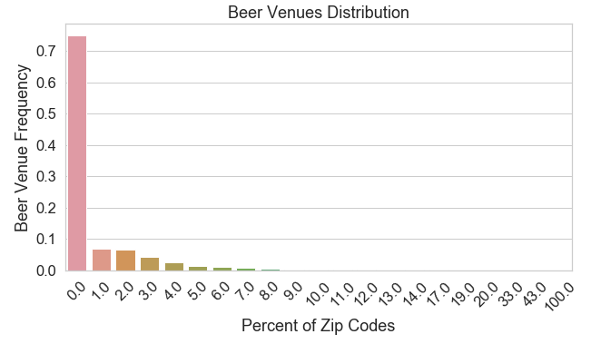
Feature Engineering
74%
of neighborhoods don’t have a Beer Venue

Slide 7
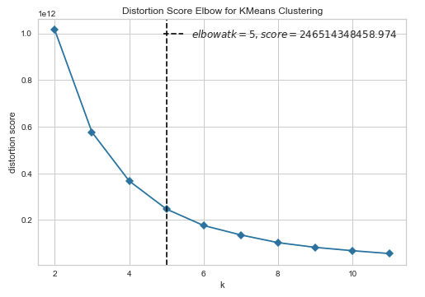
Clustering
Standard Scaler applied to features
Elbow Method used to select optimal number of clusters (5)
Number of Neighborhoods
per Cluster
Cluster | Total Zips
0 | 1623
1 | 589
2 | 799
3 | 404
4 | 129

Slide 8
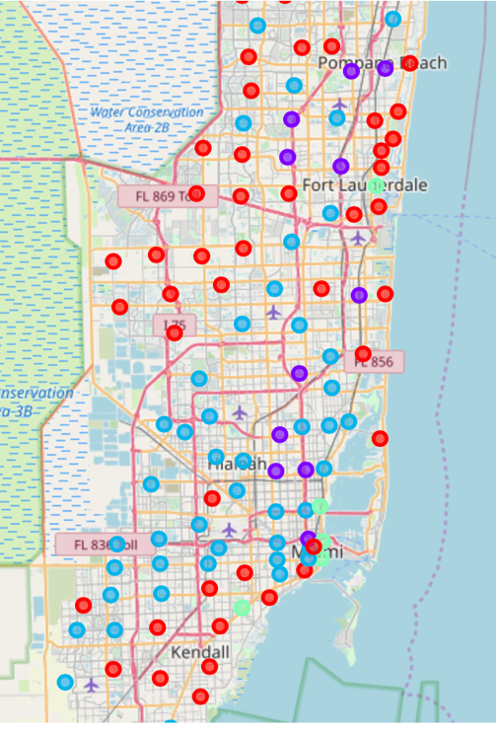
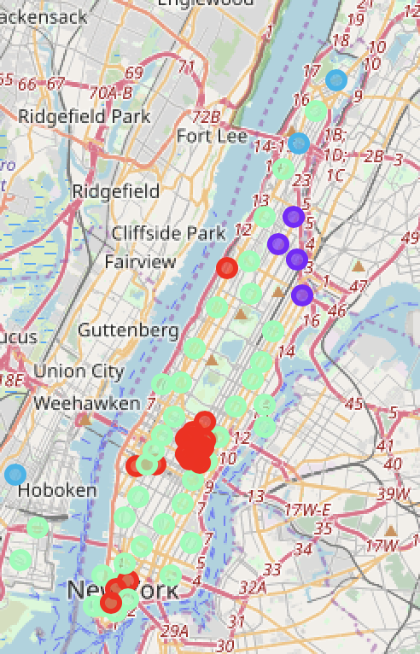
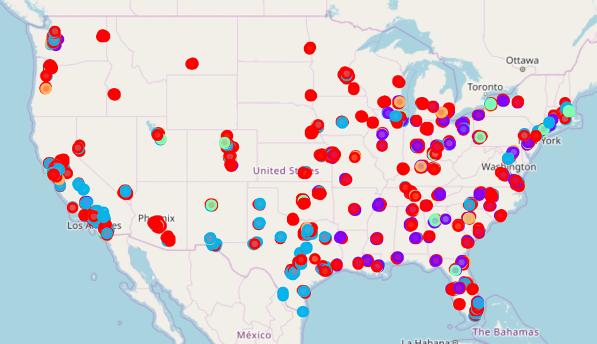
Clustering
Total US
South Florida
New York City
Legend:
Cluster 0
Cluster 1
Cluster 2
Cluster 3
Cluster 4

Slide 9
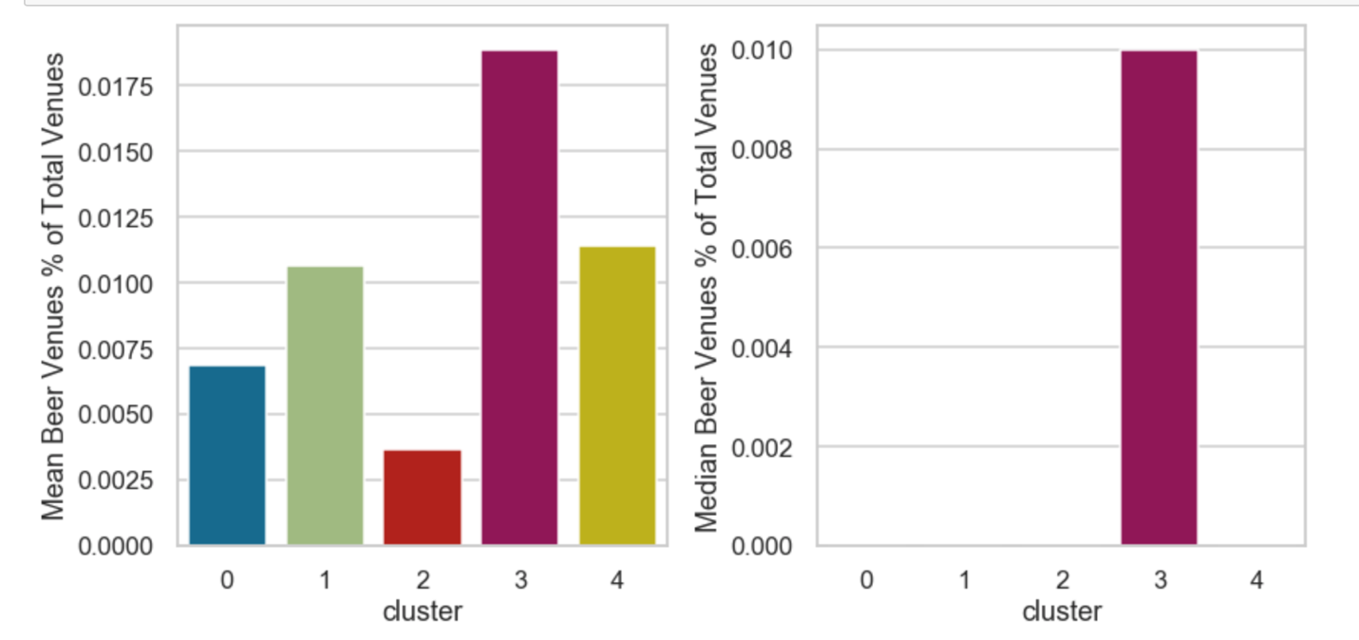
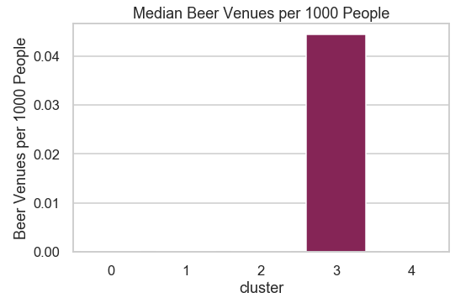
Results
Cluster 3 has more beer venues per person than others
Relative to other venues, Cluster 3 also has more beer venues

Slide 10
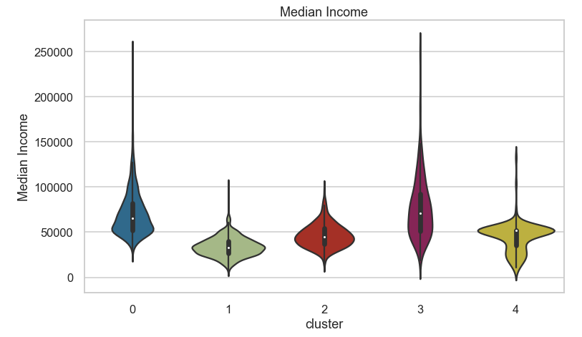
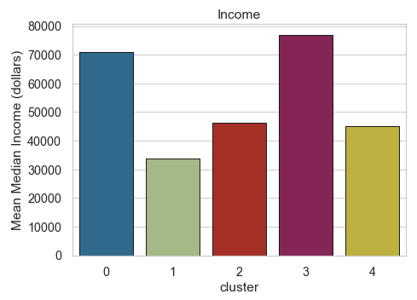
Results: Income
Cluster 3 & 0: High Income
Cluster 1: Low Income

Slide 11
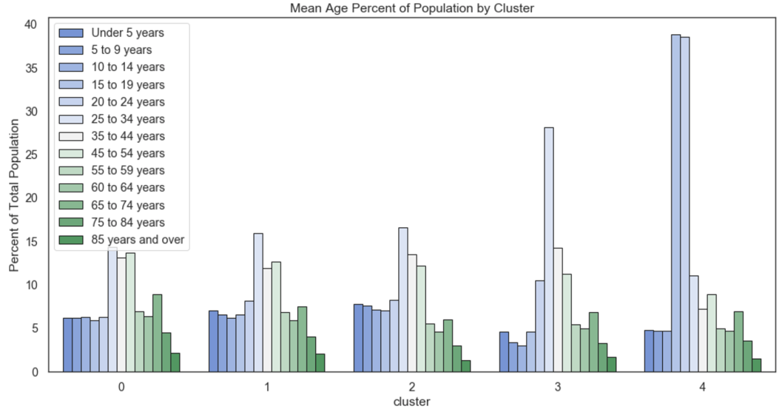
Results: Age
Clusters 3 and 4 are
younger than others

Slide 12
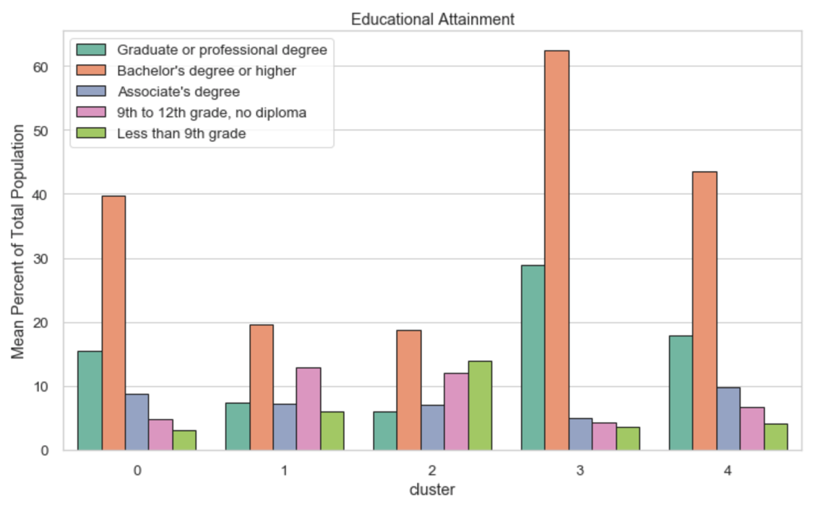
Results: Educational Attainment
Cluster 3
Highly Educated

Slide 13
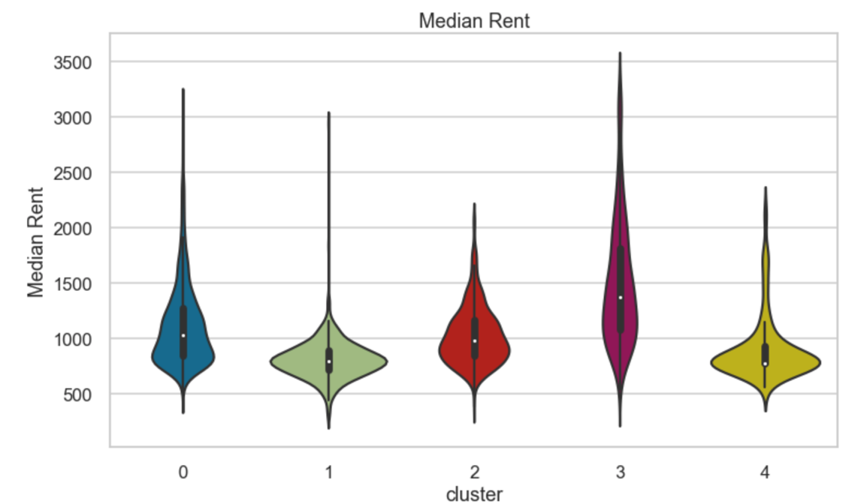
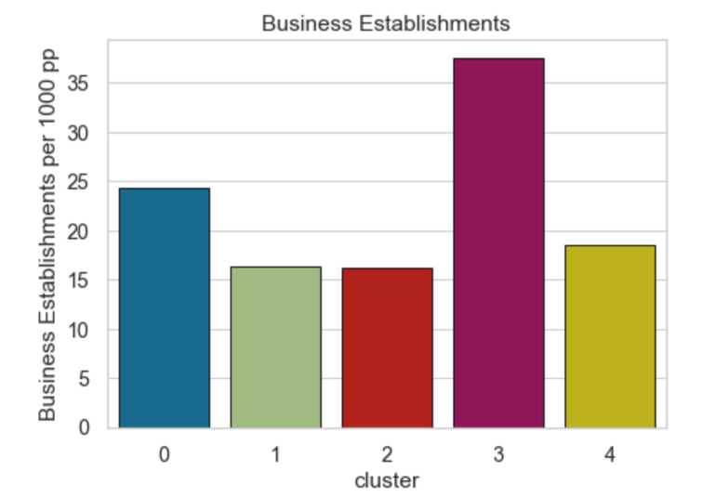
Results: Rent, Commute and Business
Cluster 3: Higher rent
Higher business density
Cluster | Mean Median Travel Time to Work (min)
0 | 24
1 | 24
2 | 26
3 | 25
4 | 15

Slide 14
Discussion: High Beer Venue Density Neighborhoods
Cluster 3:
Population
High income
Young (large amount of people ages 25-44)
Highly educated
More expensive real estate
High business establishment density

Slide 15
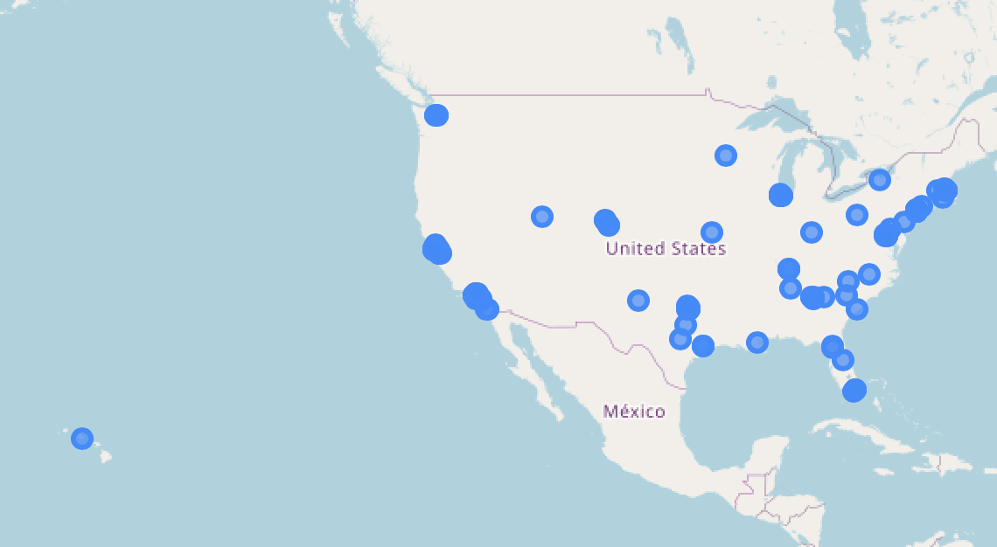
Discussion: Best Neighborhoods to Start a Beer Business
A list of neighborhoods that show potential for opening new Beer Venues is suggested. The selection logic was done by filtering the data with the following:
Cluster 3 neighborhoods
Beer Venue per 1000 People is lower than MEDIAN value for the cluster
Beer Venue Frequency People is lower than MEDIAN value for the cluster
133 neighborhoods classified as ideal
Best Neighborhoods
We want to select the neighborhoods that have lower Beer Venue density out of the ideal cluster, Cluster 3, since those neighborhoods, in theory, have lower market saturation due to their metrics being below median values
Notes:
The Median filter was used to consider that neighborhoods with lower frequencies/occurrences of Beer Venues had markets potentially less saturated of these venues, hence would be better options when opening a new venture.

